Slide 1
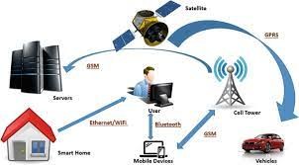
Unit 14.1 - Communication and Internet Technologies
Prepared by: Koh Kian Hua

Slide 2
Objectives
After completing this unit, students should be able to:
Show understanding of why a protocol is essential forcommunication between computers.
Show understanding of how protocol implementation can be viewed as a stack, where each layer has its own functionality.
Show understanding of the TCP / IP protocol suite, the four layers (Application, Transport, Internet, Link) and the purpose and function of each layer.
Show understanding of protocols (HTTP, FTP, POP3, IMAP, SMTP, BitTorrent) and their purposes.

Slide 3
Protocols
The Need for Protocols
When communicating over networks, it is essential that some form of protocol is used by the sender and receiver of the data.
Both parties need to agree the protocol being used to ensure successful communication takes place.
Without agreeing this protocol, it would be impossible to use parity checking.
Many different protocols exist since there are several activities taking place over the internet.

Slide 4
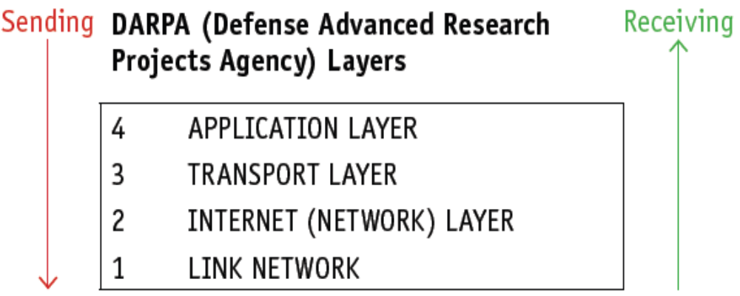
Protocols
TCP / IP Protocols
This is the four-layer structure for TCP/IP protocols:

Slide 5
Protocols
TCP / IP Protocols
When sending data across the internet (network), the layers are used in the order layer 4 to layer 1;
When receiving data across the internet (network), the layers are used in the order layer 1 to layer 4.
Each of the layers is implemented using software.

Slide 6
Protocols
Application Layer
The application layer contains all the programs that exchange data, such as web browsers or server software; it sends files to the transport layer.
This layer allows applications to access the services used in other layers and also defines the protocols that any app uses to allow the exchange of data.
There are several protocols associated with the application layer.

Slide 7
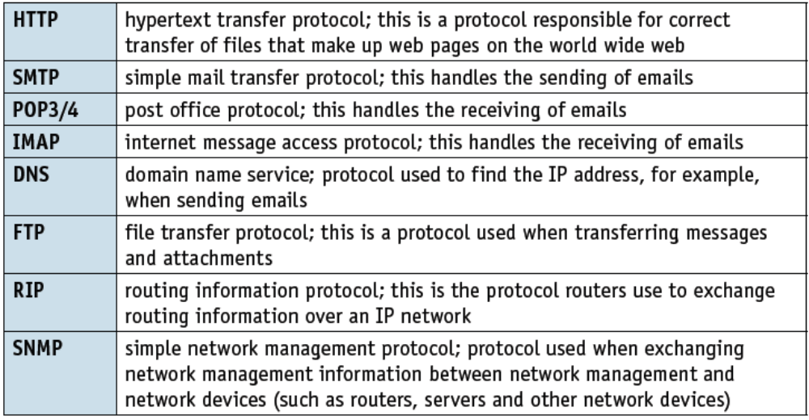
Protocols
Application Layer
Protocols associated with the application layer.

Slide 8
Protocols
Application Layer
Messages are split up into small groups of bits called packets (for example, a web page would be split up into a number of packets before sending over the network).
A router is used to transmit packets of data; routers contain connections to many other routers; when packets arrive at a router it decides where next to send them.

Slide 9
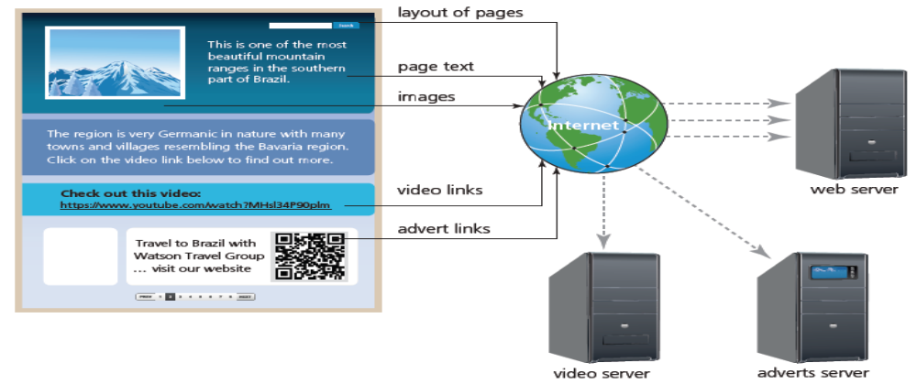
Protocols
HyperText Transfer Protocol
HTTP is probably the most important application layer protocol.
Essentially, this protocol underpins the world wide web.
It is used when, for example, fetching an HTML document from a web server

Slide 10
Protocols
HyperText Transfer Protocol
HTTP is a client/server protocol: request messages are sent out to the web servers which then respond.
HTTP protocols define the format of the messages sent and received.
The web browser (which is part of the application layer) initiates the web page request and also converts HTML into a format which can be displayed on the user’s screen or can be played through their media player.

Slide 11
Protocols
HyperText Transfer Protocol
The following summarises what happens when a user requests a web page from a website:
The user keys the URL into their browser.
HTTP(s) transmits the request from the application layer to the transport layer (TCP).
The TCP creates data packets and sends them (via port 80) to the destination port(s).
The DNS server stores a database of URLs and matching IP addresses.
The DNS server uses the domain name typed into the browser to look up the IP address of the appropriate website.
The server TCP sends back an acknowledgement (see the section on host-to-host communication on page 333).
Once communication has been established, the web server sends the web page back in HTML format to the browser.
The browser interprets the page and displays it or sends the data in the correct format to the media player.

Slide 12
Protocols
File Transfer Protocol (FTP)
The file transfer protocol (FTP) is a network protocol used when transferring files from one computer/device to another via the internet or other networks.
It is similar to HTTP and SMTP, but FTP’s only task is the application protocol for the transfer of files over a network.
Web browsers can be used to connect to an FTP address in a way similar to HTTP, for example, ftp://username@ftp.example.gov/

Slide 13
Protocols
File Transfer Protocol (FTP)
Additional features of FTP include:
anonymous ftp – this allows a user to access files without the need to identify who they are to the ftp server; for example, ‘331 Anonymous access allowed’ would be a message received to confirm anonymous access.
ftp commands – a user is able to carry out actions that can change files stored on the ftp server; for example, delete, close, rename, cd (change directory on a remote machine), lcd (change directory on a local machine)
ftp server – this is where the files, which can be downloaded as required by a user, are stored.

Slide 14
Protocols
Simple Mail Transfer Protocol (SMTP)
Simple mail transfer protocol (SMTP) is a text-based (and connection-based) protocol used when sending emails.
Since SMTP is text-based only, it doesn’t handle binary files (a binary file is a file containing media/images as well as text and is regarded as being computer readable only).
If an email contains attachments made up of images, video, music then it is necessary to use the multi-purpose internet mail extension (MIME) protocol instead.
A MIME header is used at the beginning of the transmission; clients use this header to select which media player is needed when the attachment is opened.

Slide 15
Protocols
POP3/4 and IMAP
Post office protocol (POP3/4) and internet message access protocol (IMAP) are protocols used when receiving emails from the email server.
These are known as pull protocols (the client periodically connects to a server; checks for and downloads new emails from the server – the connection is then closed;
this process is repeated to ensure the client is updated).
IMAP is a more a recent protocol than POP3/4, but both have really been superseded by the increasing use of HTTP protocols.
However, SMTP is still used when transferring emails between email servers.

Slide 16
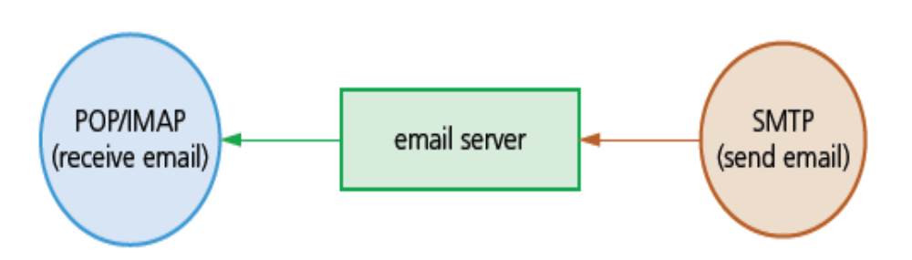
Protocols
POP3/4 and IMAP
An overall view of the email protocol set up.

Slide 17
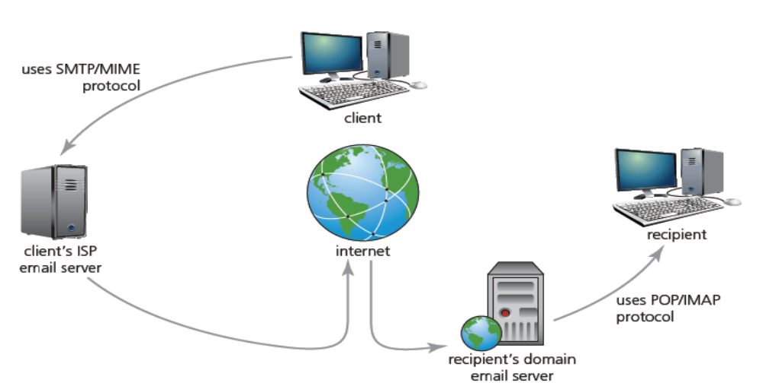
Protocols
POP3/4 and IMAP
A detailed view of the email protocol set up.

Slide 18
Protocols
POP3/4 and IMAP
Main difference between POP3/4 and IMAP.
POP | IMAP
POP3/4 does not keep the server and client in synchronisation; when emails are downloaded by the client, they are then deleted from the server which means it is not further updated. | IMAP keeps the server and client in synchronisation; only a copy of the email is downloaded with the original remaining on the server until the client manually deletes it.

Slide 19
Protocols
Transport Layer
The transport layer regulates the network connections; this is where data is broken up into packets which are then sent to the internet/network layer (IP protocol).
The transport layer ensures that packets arrive in sequence, without errors, by swapping acknowledgements and retransmitting packets if they become lost or corrupted.
The main protocols associated with the transport layer are transmission control protocol (TCP), user datagram protocol (UDP) and SCTP.

Slide 20
Protocols
Transmission Control Protocol (TCP)
TCP is responsible for the safe delivery of a message by creating sufficient packets for transmission.
It uses positive acknowledgement with retransmission (PAR) which means it automatically re-sends a data packet if it has not received a positive acknowledgement.
TCP is also connection orientated since it establishes an end-to-end connection between two host computers using handshakes.
For this last reason, TCP is often referred to as a host-to-host transmission protocol.

Slide 21
Protocols
Transmission Control Protocol (TCP)
These are the steps taken when host computer ‘X’ communicates with another host ‘Y’ (this is an expansion of what happens during TCP involvement shown in the HTTP algorithm earlier on):
Host ‘X’ will first of all send host ‘Y’ a segment (packet) which will include synchronisation sequence bits so that segments will be received in the correct order.
Host ‘Y’ will now respond by sending back its own segment (containing an acknowledgement together with its own synchronisation sequence bits).
Host ‘X’ now sends out its own acknowledgement that the segment from ‘Y’ was received.
Transmission of data between ‘X’ and ‘Y’ can now take place.

Slide 22
Protocols
Internet/network layer and network/data-link layer
The internet layer identifies the intended network and host. The common protocol is IP (internet protocol).
The network/data-link layer identifies and moves traffic across local segments, encapsulates IP packets into frames for transmission, maps IP addresses to MAC (physical) addresses and ensures correct protocols are followed.
The physical network layer specifies requirements of the hardware to be used for the network.
The data-link layer identifies network protocols in the packet header (TCP/IP in the case here) and delivers packets to the network.

Slide 23
Protocols
Internet/network layer and network/data-link layer
This is a summary of the IP functions:
Ensure correct routing of packets of data over the internet/network.
Responsible for protocols when communicating between networks.
Take a packet from the transport layer and add its own header which will include the IP addresses of both sender and recipient.
The IP packet (datagram) is sent to the data-link layer where it is assembles the datagrams into frames for transmission..

Slide 24
Protocols
Ethernet Protocols
Ethernet is a system that connects a number of computers or devices together to form a LAN.
It uses protocols to control the movement of frames between computers or devices and to avoid simultaneous transmission by two or more devices.
It is a local protocol and does not provide any means to communicate with external devices.
It requires the use of IP which sits on top of the Ethernet protocol.

Slide 25
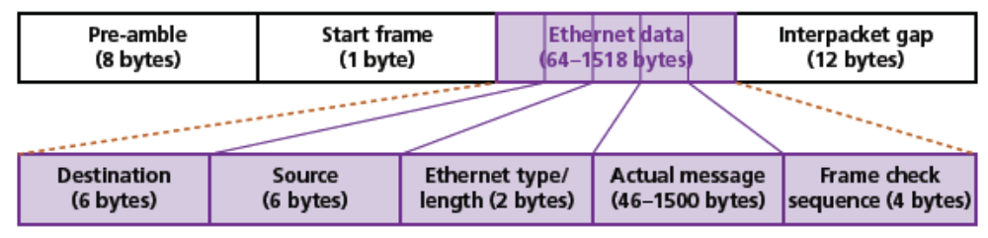
Protocols
Ethernet Protocols
The figure below shows the make-up of a typical frame used by the Ethernet protocol.

Slide 26
Protocols
Ethernet Protocols
The components that make up Ethernet data are:
destination – this is the MAC address of the destination computer or device (it is possible to use the value FF:FF:FF:FF:FF:FF as the MAC address if the sender wishes to target every device (for example, to advertise services)
source – this is the MAC address of the source computer (using the usual MAC address format of 6 bytes).
Ethernet type or length – if the frame length ≤ 1539 then the value here is the length of the Ethernet frame; if the frame length > 1539 then the value here is the Ethernet type (IPv4 or IPv6 in our example).
frame check – this will include a checksum to provide a method of checking data integrity following transmission of the frame.

Slide 27
Protocols
Wireless (Wifi) Protocols
Wireless LANs (standard IEEE 802.11 protocol) use a MAC protocol called carrier sense multiple access with collision avoidance (CSMA/CA).
CSMA/CA uses distributed control function (DCF) to ensure a WiFi device can only transmit when there is a free channel available.
Since all transmissions are acknowledged when using DCF, if a device does not receive an acknowledgement it will assume a collision will occur and waits for a random time interval before trying again.

Slide 28
Protocols
Bluetooth Protocols
It uses the standard IEEE 802.15 protocol for short-range data transmission/communication.
There are numerous additional Bluetooth protocols due to the many applications that may use this wireless connectivity;

Slide 29
Protocols
Peer-to-peer file sharing/BitTorrent protocol
The BitTorrent is a protocol which is based on the peer-to-peer networking concept.
This allows for very fast sharing of files between computers (known as peers).
The concept of sharing files using BitTorrent can be used by thousands of users who connect together over the internet.
The BitTorrent protocol allows many computers (acting as peers) to share files.

Slide 30
Protocols
Peer-to-peer file sharing/BitTorrent protocol (Example)
Initially, to share a file, the peer (computer ‘A’) creates a small file called a torrent.
The torrent contains metadata about the file about to be shared.
The actual file is broken up into equal segments known as pieces
Other peers who wish to download this file must first obtain the torrent and connect to the appropriate tracker – a central server that contains data about all of the computers connected to it.
As each peer receives a piece of file they then become a source for that piece of file. Other peers connected to the tracker will, therefore, know where to find
the piece of file they need.
Once a peer has downloaded a file completely and they make the file (or required pieces of the file) available to other peers in the swarm (a group of
peers connected together), they become a seed.
The more seeds in the swarm, the faster the file downloading process between peers.
Usually, once a file is fully downloaded, a peer is requested to remain online so they can become part of the seeding process until all peers have received the whole file.

Slide 31
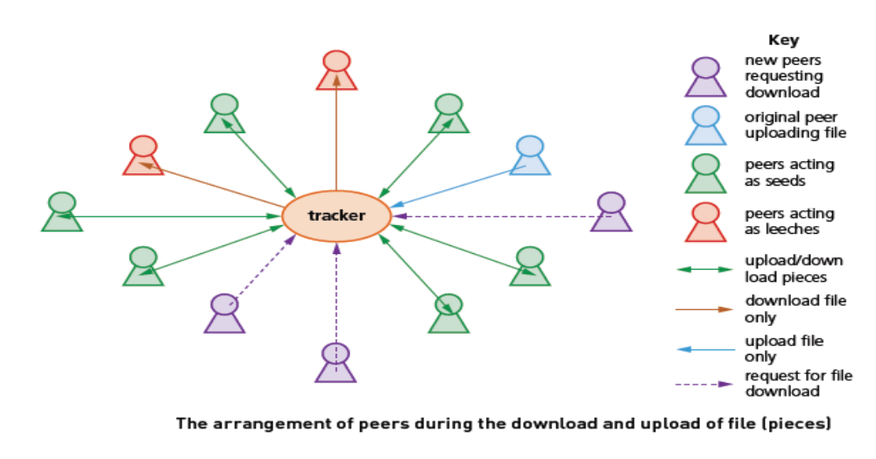
Protocols
Peer-to-peer file sharing/BitTorrent protocol (Example)

Slide 32
Protocols
Class Activity
1 a) Name the four layers which show the TCP/IP protocols.
b) Name one protocol associated with each layer.
c) i) Describe the use of protocols when sending and receiving emails.
ii) What is the difference between SMTP and MIME when sending
emails?

